Slide 1
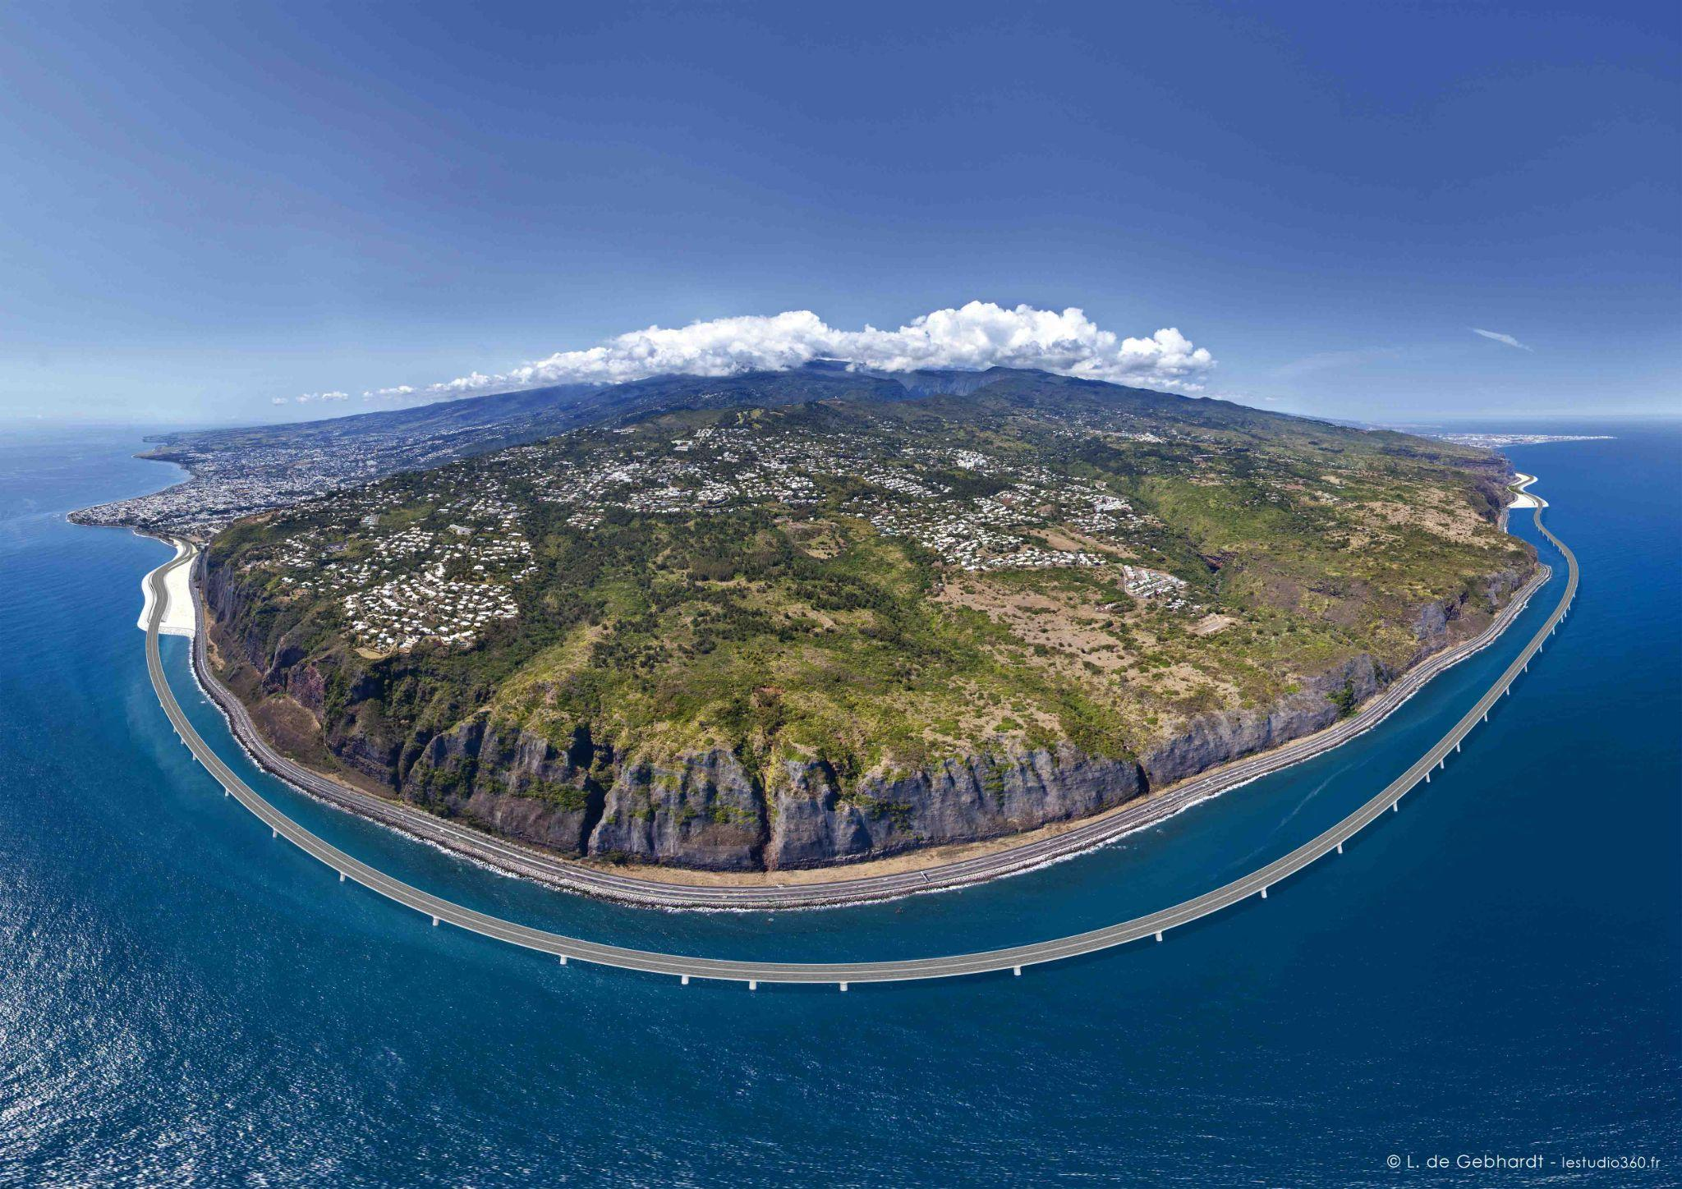
Dataset Analysis of Island Effect Studies
By Colton Augustine

Slide 2
The Problem of Island Effects
What is an Island Effect?
Example
Why is this Worth Studying?
A syntactic island arises from wh-movement when a clause remains in its original position in the sentence, now maintaining a long distance syntactic dependency with the wh-particle
Deep structure:
The accountant did scream when Kerry fired *Who*? —>
*Who did the accountant scream when Kerry fired?
Island effects are a controversial problem in syntax, especially in syntactic processing within psycholinguistics, as they are found throughout human language and can be used as a test case in the processing vs. grammar debate.

Slide 3
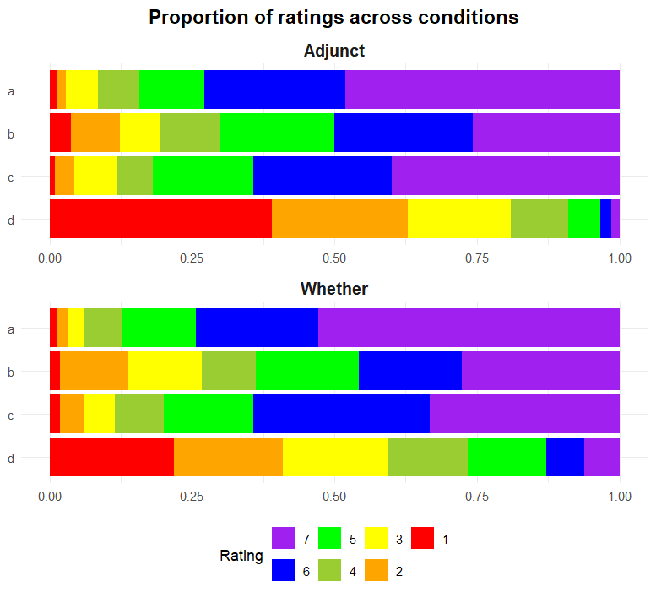
From Sprouse et al. (2012) to our Study Design
Sprouse’s Study Design
Modifications
Our Dataset
Dependent Variable is acceptability judgements on the Likert Scale
2 x 2 Factorial Design
The first factor is Island vs Non-island
Second factor is Matrix vs Embedded
Whether vs. Adjunct
Our experiment maintains the Likert Scale and Factorial Design, however we narrowed the focus to comparing two specific types of island effects in English. Sprouse also tested working memory of participants, which we did not.
The data set then consists of 8 different combinations of factors and categories. Table 1

Slide 4
Sprouse’s Tests What We Will Run
In their analysis of the data, Sprouse and his team do a few key things:
Quantify island effects with Differences-in-Differences (DD) Scores
Run simple linear regressions with DD scores as the dependent variable and working memory scores as the independent
Create linear mixed-effects regression models (LMERs) using Baayen’s methodology
Estimate p-values with the MCMC method (which we will not do)
Interpret Data!
It’s worth noting that Sprouse’s study is 13 years old, so the methodology is a little dated. Here’s what we will use instead:
The lme4 package
Newer lmer methodology
However, the apparent best practice now is to use cumulative link mixed-effects models (CLMMs)
Assumption tests

Slide 5
Analysis and Findings

Slide 6
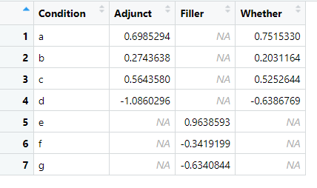
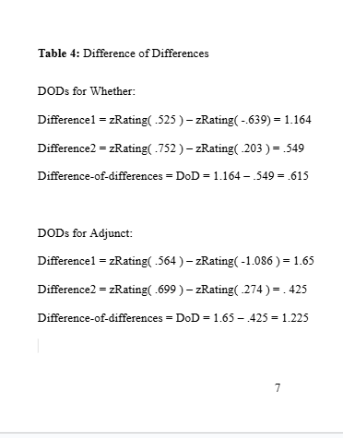
Looking at Our Data
Before I began this assignment, I had to analyze these data for my psycholinguistics course. We will briefly evaluate those tables before continuing.

Slide 7
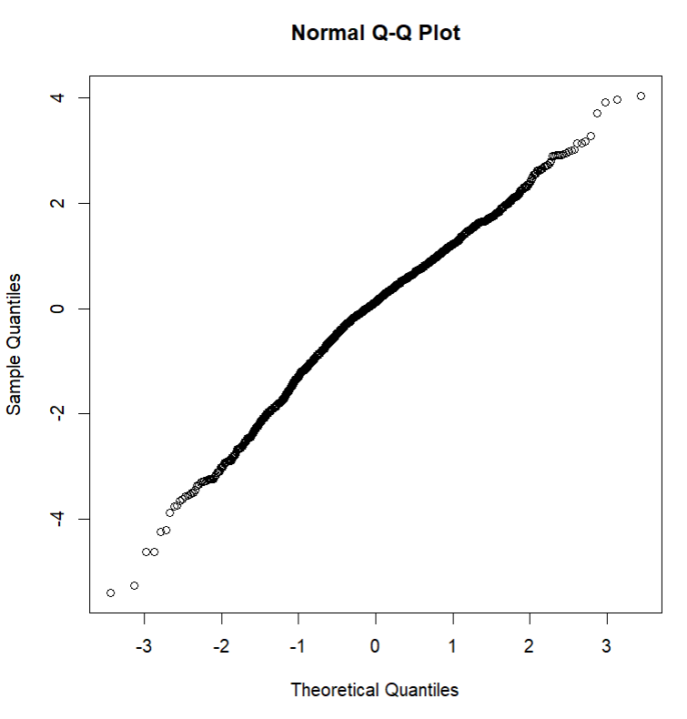
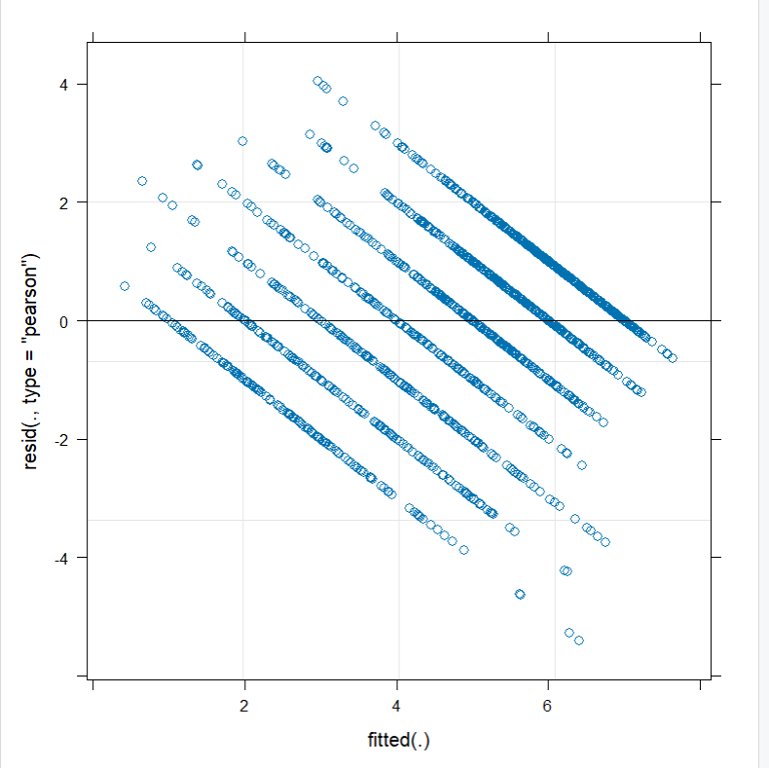
Assumption Checks
Here, we check our lmer for linearity, homoscedasticity, normality, and multicollinearity. Looks fine!

Slide 8
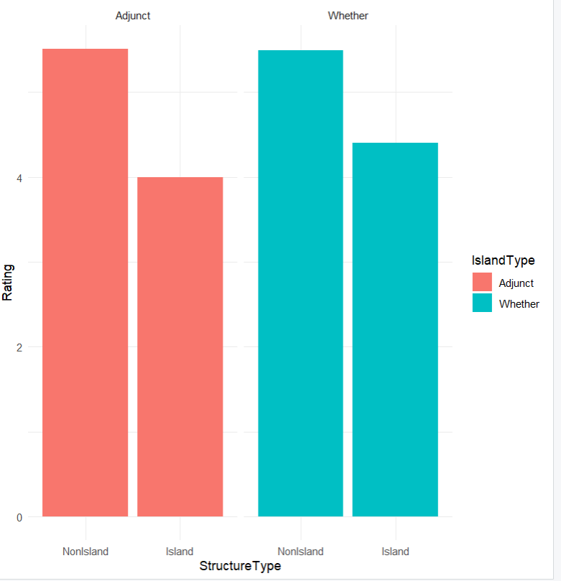
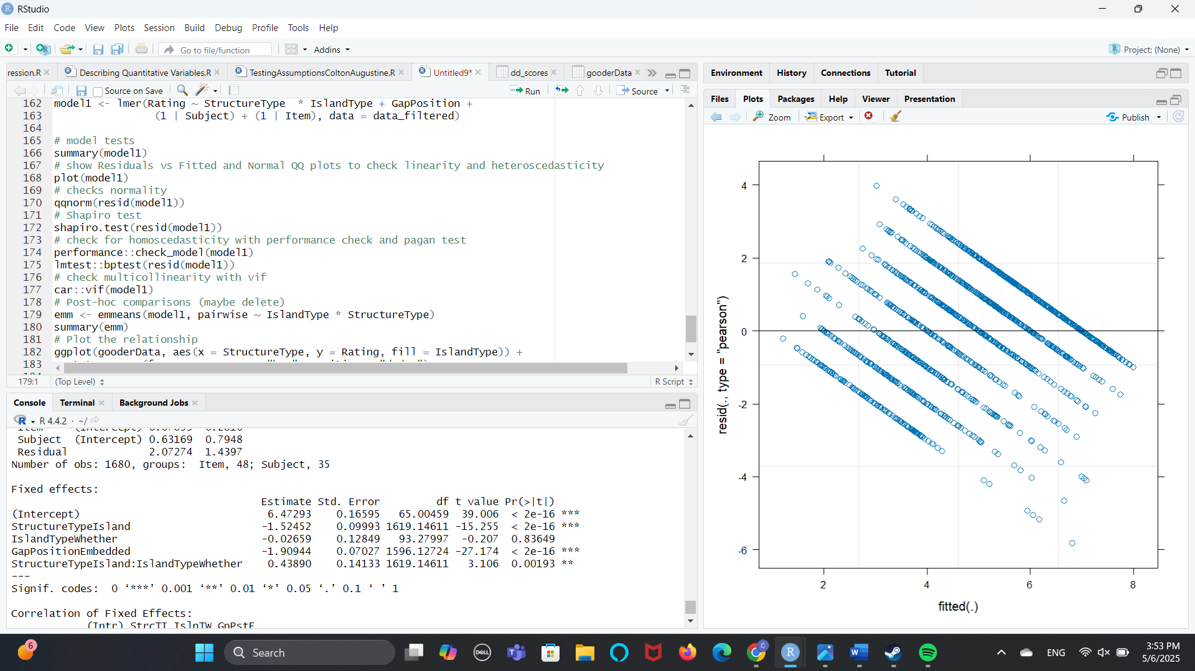
Final Model!
We can see clearly that there is a preference for the non-island, whether, matrix sentence type, but not for the whether type overall. Great success!
lmer code:
model1 <- lmer(Rating ~ StructureType * IslandType + GapPosition + (1 | Subject) + (1 | Item), data = data_filtered)

Slide 9
Citations
Sprouse, J., Wagers, M., & Phillips, C. (2012). A test of the relation between working-memory capacity and syntactic island effects. Language, 88(1), 82–123. https://doi.org/10.1353/lan.2012.0004.

Slide 10
Thanks for Listening!

